Slide 1

www.thegemini.co.in
CORPORATE PROFILE
Notes:
Photo by Adeolu Eletu - unsplash.com

Slide 2

INTRODUCTION
Thank you for your interest in The Gemini. We are living in the era of Information Technology. There is no need to describe the importance & significance of the wide - spread use of software systems. There is always a demand for custom software as each business has its own requirement. For the hanging nature of requirements and complexity of enterprise applications, we must consider good adaptability. We have defined our development standards for project management, methodologies, project templates for different requirements, reusable libraries, coding and naming standards according to industry standards and best practices. It also enables us to efficiently use of resource resulting low development cost. This is the way how we produce creative, effective and cost effective customized solutions for you, and measure our success by your success, you are our partners, we are sharing success together.

Slide 3

AGENDA
The information contained in this packet provides you with a brief introduction to who we are, what we do, and how The Gemini can be of value to your business. To accomplish this, we present an overview of our services, highlight our capabilities, and offer some brief examples of our experience. The content is broken down as follows: Corporate Overview, Available Services, Products, Our Team, Process & Contact Information.
Because every client’s project poses its own set of unique challenges, it is impossible to compose one
document that completely addresses everyone’s specific needs. What we have attempted to do in the following pages is simply provide a glimpse into some of our capabilities. The Gemini is a full custom services firm. As such, it’s our business to quickly adapt to meet our clients’ diverse needs and we have a proven track record of doing just that.

Slide 4



Headquartered in Ahmedabad, India, The Gemini is a leading Global Enterprise Software Provider with a reputation for Innovative Products and Outstanding Services. The company provides enterprise software solutions to multiple verticals, including Healthcare, Education, Corporate Houses, Public sector and more. Our experienced staff of professionals has worked with a wide array of platforms , languages, and tools in the course of our various projects
Since 2000
The Gemini is a Software Development and IT Consulting company with more than 19 years of experience in the market.
We are 100+ people, distributed in our Three development centers in Ahemedabad, Gujarat (our headquarters), Ajmer & Kolkata.
Spotless delivery record of many successful projects over many years.
Technology partners with software product companies globally and partner with many software development houses across the globe.
A dedicated team of brilliant software professionals.
WHO WE ARE
Notes:
Photo by Samuel Zeller.

Slide 5
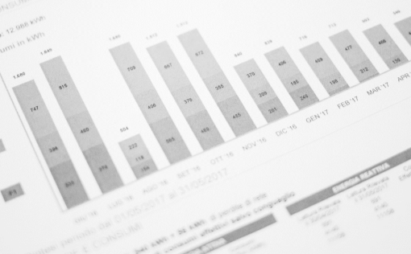



MISSION
&
Our goal is to empower industries and enterprises around the globe to attain cutting edge technologies and have ultimate business efficiency in everyday processes of the organization. Our Mission is to provide a top quality development service to achieve client's business objective. To make this happen, our industry experts adhere to well-framed progress methodologies, global delivery model and rigid QA systems, through which we provide business-critical solutions on-time, within budgets and within desired levels of performance. Our proven solutions and services will accelerate the potential of your website in the online market and increase ROI manifold.
VISION
“ To be a globally leading & passionate IT service company delivering technological innovations in a partnership approach. We embrace integrity, respect & commitment in our relationship with customers, partners & employees “
Notes:
Photo by Samuel Zeller and Giorgio Tomassetti - unsplash.com

Slide 6

WHY – THE GEMINI ?
Global Presence.
State-of-the-art infrastructure.
Proven offshore outsourcing model.
Multi-cultural & Multi-location understanding
Consistent growth & performance.
Localize existing software for use in other countries & markets.
Domain knowledge. Easy access to the team in India.
Flexible to work with the needs of the client.
High-quality and cost-effective services
Diverse teams of highly qualified IT Professionals
Latest software and technologies
One-stop-shop for all IT needs
Proven infrastructure to provide 24x7 supports globally.

Slide 7

DIFFERENTIATORS:
Excellent Service
Round the Clock Support
Value for Money
Delivering a true cost – benefit
Proven track record
Wide spectrum of services
Flexible business models
Continuous Technology Adaptation
Extremely Competitive
High Degree of Flexibility
User Friendly and Impressive GUIs
Multi-Platform Compatibility

Slide 8
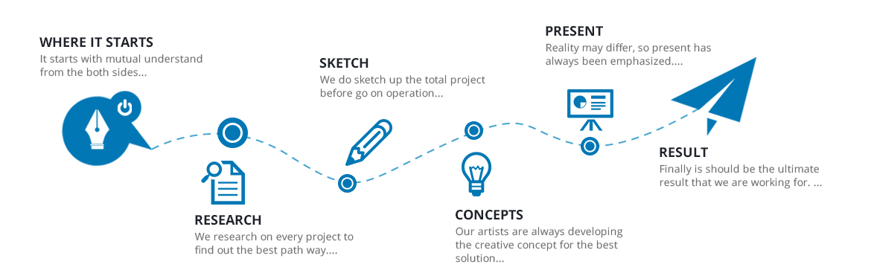
DEVELOPMENT PROCESS

Slide 9
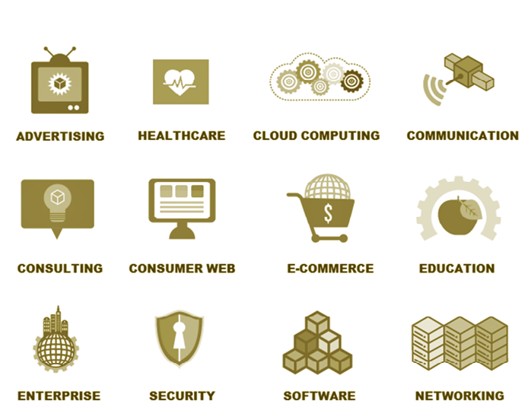
INDUSTRIES WE SERVE :

Slide 10
IT SKILLS:
WEB PROGRAMMING:
GRAPHICS AND ANIMATION:
SOFTWARE TOOLS:
DATABASE:
HTML
PHP
JSP
J2EE
ASP
XML
Perl
ASP.NET
AJAX
Adobe Photoshop
Adobe illustrator
Macromedia Firework
Macromedia Flash
Adobe Premiere
Adobe After Effect
Real Media
Windows Media
Crystal Reports
Install Shield
Microsoft Visio
Microsoft Project
MySQL
MS Access
MS SQL Server
Oracle
www.thegemini.co.in
PROGRAMMING
VB .NET
C# Sharp
Visual Basic

Slide 11
ABOUT
OUR SERVICES
We write code. However, unlike most software companies, we realize that's only part of the job. We don't just write code… We develop professional software. This is why our clients choose The Gemini. Our ability to develop code is only the beginning of our capabilities. Being a “custom” firm, The Gemini is able to provide our clients with a variety of services.
Notes:
Photo by Adeolu Eletu - unsplash.com

Slide 12








SERVICES
We create IT-enabled business solutions for our clients by leveraging our domain and business expertise along with a complete range of services.
IT SERVICES
CONSULTING
SERVICES
BPO SERVICES
HOSPITAL
BRANDING
DOMAIN
REGISTRATION
WEBSITE
DEVELOPEMENT
PORTAL
DEVELOPMENT
HOSTING
SERVICES

Slide 13







OUR SOLUTIONS
HOSPITAL INFORMATION MANAGEMENT SYSTEM
SPECIALTY EHR
( IVF, DENTAL, ONCO )
HR & PAYROLL
MANAGEMENT SYTEM
TELEMEDICINE
MANAGEMENT
SYSTEM
EDUCATION SUPPORT SYSTEM
( SCHOOL, COLLEGE & UNIVERSITIES )
LABORATORY
MANAGEMENT
SYSTEM

Slide 14




HOSPITAL INFORMATION MANAGEMENT SYSTEM
We customize HIMS as per the specific requirement of the healthcare center. Our technology specialists configure Hospital Information Management System to serve the exact purpose and meet the objectivity of its installation

Slide 15
HIMS MODULES
HOSPITAL INFORMATION MANAGEMENT SYSTEM
ADMIN | HELP DESK | OPD | IPD
OT | MRD | LABORATORY | RADIOLOGY
PHARMACY | NRX | BLOOD BANK | DIET MANG.
MEDICLAIM | HR & PAYROLL | STORE | ACOUNTS
AMBULANCE | CSSD | BIOMEDICAL WASTE | LINEN & LAUNDRY
MAIL CENTER | MIS

Slide 16



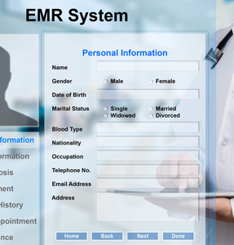
SPECIALTY EHR SYSTEM
A specialty focused solution with point-and-click selection, customization capability and automation tools to support your unique practice style, preferences and workflow.
Get an EHR that fits your specific practice —Join the many different specialty practices & professionals that use the Gemini speciality EHR.

Slide 17
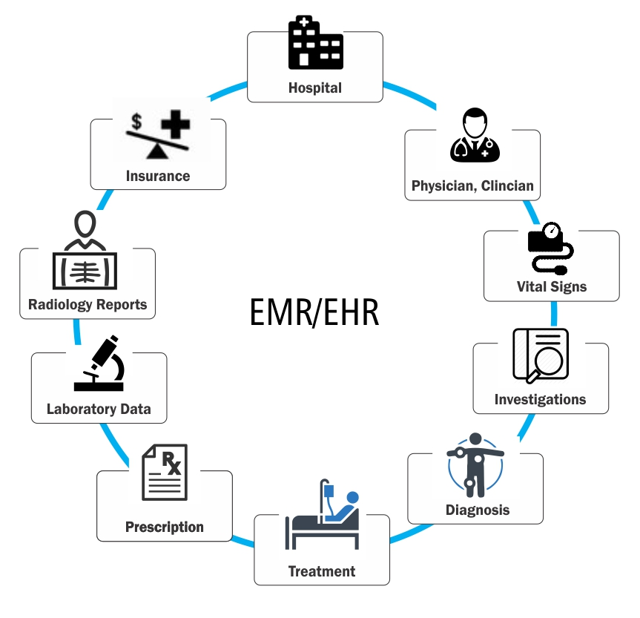


Slide 18
SPECIALTY EHR SYSTEM
DENTAL EHR
Manage all your Dental practices
ONCO EHR
Everything you need in an EHR for Oncology Clinics
FERTILITY EHR
It is designed and developed as IVF Software to deliver palpable benefits to Infertility clinics.
Online patients form
Dental x-ray imaging
Digital documents
Online dental treatment plans
Dental billing and insurance
Graphical tooth charting
Appointment Booking
Reports
Oncology-specific Templates
Quick Treatment Documentation
Chemotherapy Scheduling
E-Prescribing and Prescriptions
Authorization / Referral Tracking
Treatment Comparison
Document & Image Management
Lab Ordering, Reviewing tracking
Patient on boarding and management
Fertility Analysis & Treatment Management
Consent Management
Embryo Freezing, Cryo Bank & Record Tracking
Fertility Preservation Management, Tracking & Reporting
Flexible Reports with Statistical Analysis
www.thegemini.co.in

Slide 19




LABORATORY INFORMATION MANAGEMENT SYSTEM
Patients, doctors and consultants rely on laboratories to provide accurate data 100% of the time. The Gemini Pathology LIMS helps to provide this with instrument interfacing to automate the import of analysis results. This eliminates typographical errors and speeds up the laboratory throughput, reducing operational costs. Our Lab Information Management System is a product that coordinate and integrate all the activities involved in the management and running of a pathology center.

Slide 20
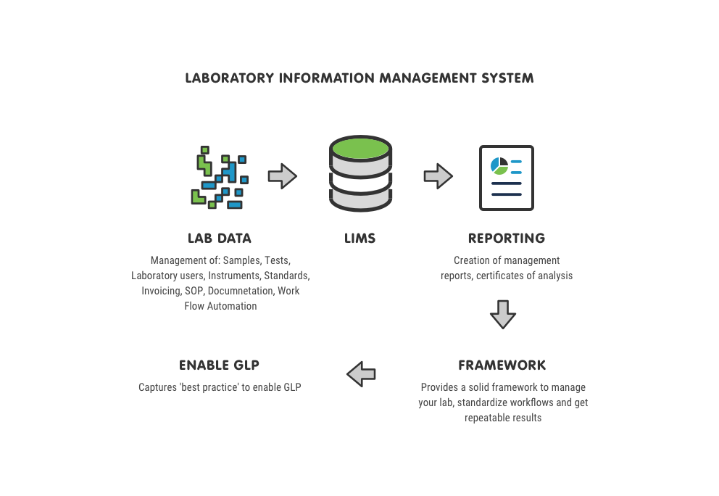
LABORATORY INFORMATION MANAGEMENT SYSTEM

Slide 21


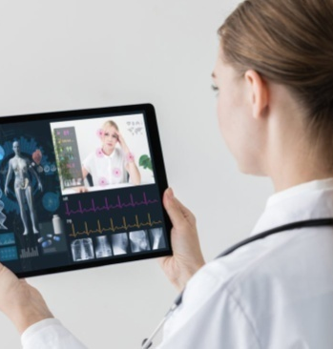

TELEMEDICINE MANAGEMENT SYSTEM
The Gemini telemedicine and TeleHealth systems depend upon the unique access of providing the suppliers with advanced features like video chat, digital prescriptions, digital health data, medical consultancy, appointment booking and much more. The systems are handy, easy to use and very intuitive for the users. Therefore, you do not need any technical knowledge to work on the software as it comes fully integrated & ready-to -use.

Slide 22
PATIENT CENTRIC TO ENHANCE THE USER EXPERIENCE
Video Conferencing: Connects Doctor’s At The Main Centers With Built In Videoconferencing To Provide Online Opinion, Diagnosis And Treatment To The Patients In Remote Locations.
Secure Remote Access: Guarantees A Secure Remote Access To The Medical Data Of The Patient Saving The Patient Data In EMR
Teleconsultation : Offers Web Based Teleconsultation, Tele- Ecg, Vital Signs Monitoring And Specialized Services In Radiology, And Cardiology In Real Time.
Records And Captures Patient Information: Records And Captures Patient Information In Real-time, Capturing Vitals Via Sensors In The EMR Linked With Hospital Information System From Remote Locations.
Care Taking : Takes Care Of The Patient Record And The Entire Telemedicine Center With The Help Of The Specialized Enterprise Structure.
Refers The Patient : Refers The Patient From One Specialist To Another Specialist From System For Primary Care, Secondary Care And Tertiary Care
Pre And Post-operative Care: Pre And Post-operative Care Of Patients Located Remotely, By Real Time Web- Based Tele-consultation Features, Enabling Faster Follow-up Treatment.
TELEMEDICINE MANAGEMENT SYSTEM

Slide 23

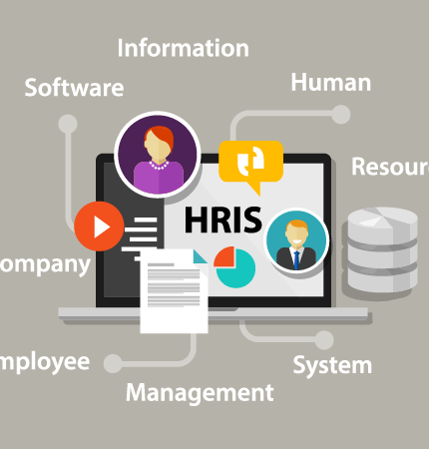


HR & PAYROLL MANAGEMENT SYTEM
The Gemini HRMS Solution helps to manage a truly paperless office by maintaining the documents electronically and sending e-Pay slip through e-mail etc. The Gemini Human Resource Management System allows setup unlimited number of employees, departments, projects, allowances, deductions etc.

Slide 24
HR & PAYROLL MANAGEMENT SYTEM
MODULES :
Employee Management
Leave Management
Time & Attendance System
Employee Training Programs
Document Management
Allowance & Deductions
Loans & Advances
Tour Management
FEATURES :
Complete History of Employees
Attendance machine integration
Flexible Payroll Calendar
Document Management
Earnings, Deductions and Over Time
Project / Job Costing.
Personal Information Management
Advanced Reporting
Advanced Leave Management
Employee Performance Management

Slide 25






OUR CLIENTELE :
ANJALI
HOSPITAL
ASHOK HOSPITAL
BABYJOY
HOSPITAL
CANCER
HOSPITAL
FERTICITY
HOSPITAL
GLOBUS
HOSPITAL

Slide 26






OUR CLIENTELE :
KPC
HOSPITAL
LAKSHMI HOSPITAL
ORCHID
HOSPITAL
RR HOSPITAL
SHREE
HOSPITAL
SHREYAS
HOSPITAL

Slide 27







OUR CLIENTELE :
SVCA
HOSPITAL
UNITED MEDICITY
USTHI
HOSPITAL
RLJ
HOSPITAL
GURUDEV
HOSPITAL
SHRI RAMKRISHANA HOSPITAL
BIMAL HOSPITAL

Slide 28

OUR LOCATIONS :
Development Cell : Ahmedabad, Ajmer, Kolkata
Technical Support : Udaipur, Mumbai, Bangalore, Noida, Pune, Kolkata, Bhubaneswar
Business Address : Berlin, Germany
The Gemini Partner : Nigeria, Kenya, Uganda, UAE, Trinidad

Slide 29




+91 9265562676
consultants@thegemini.co.in
www.thegemini.co.in
TO DISCUSS YOUR NEEDS OR FOR A COMPREHENSIVE DEMONSTRATION OF THE ANY THE GEMINI PRODUCT OR SERVICE CONTACT US
Notes:
Photo by Adeolu Eletu - unsplash.com

Slide 30


We are always interested in exploring new projects, so if you’re interested in discussing your particular development challenges with us, please contact us at: The Gemini. We’re confident that our staff of experienced professionals can be a valuable addition to your team.

